Slide 1


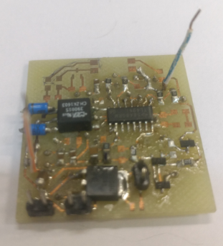
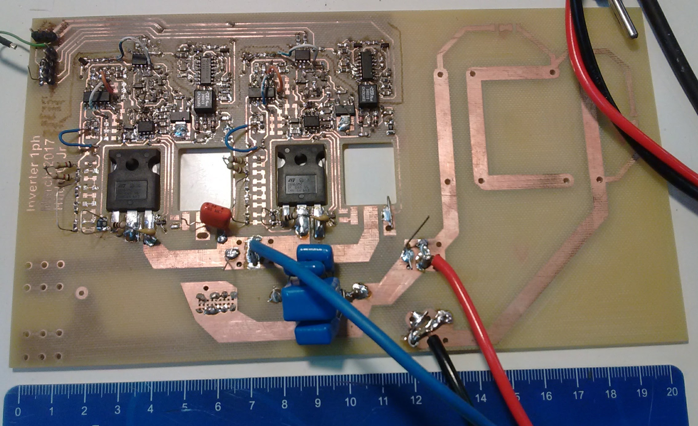
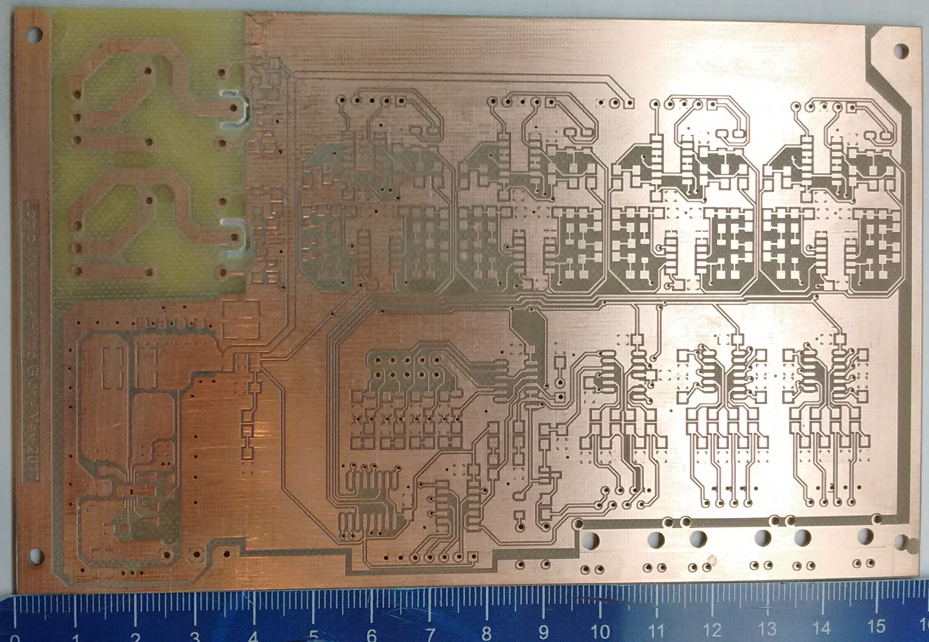
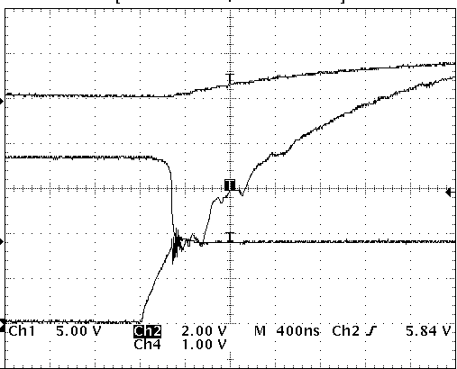
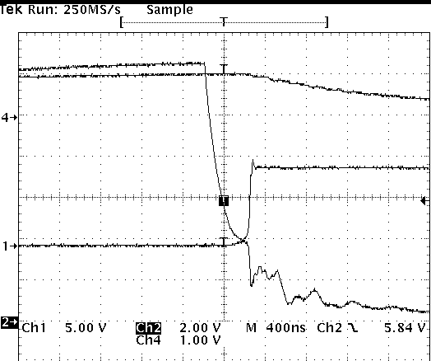
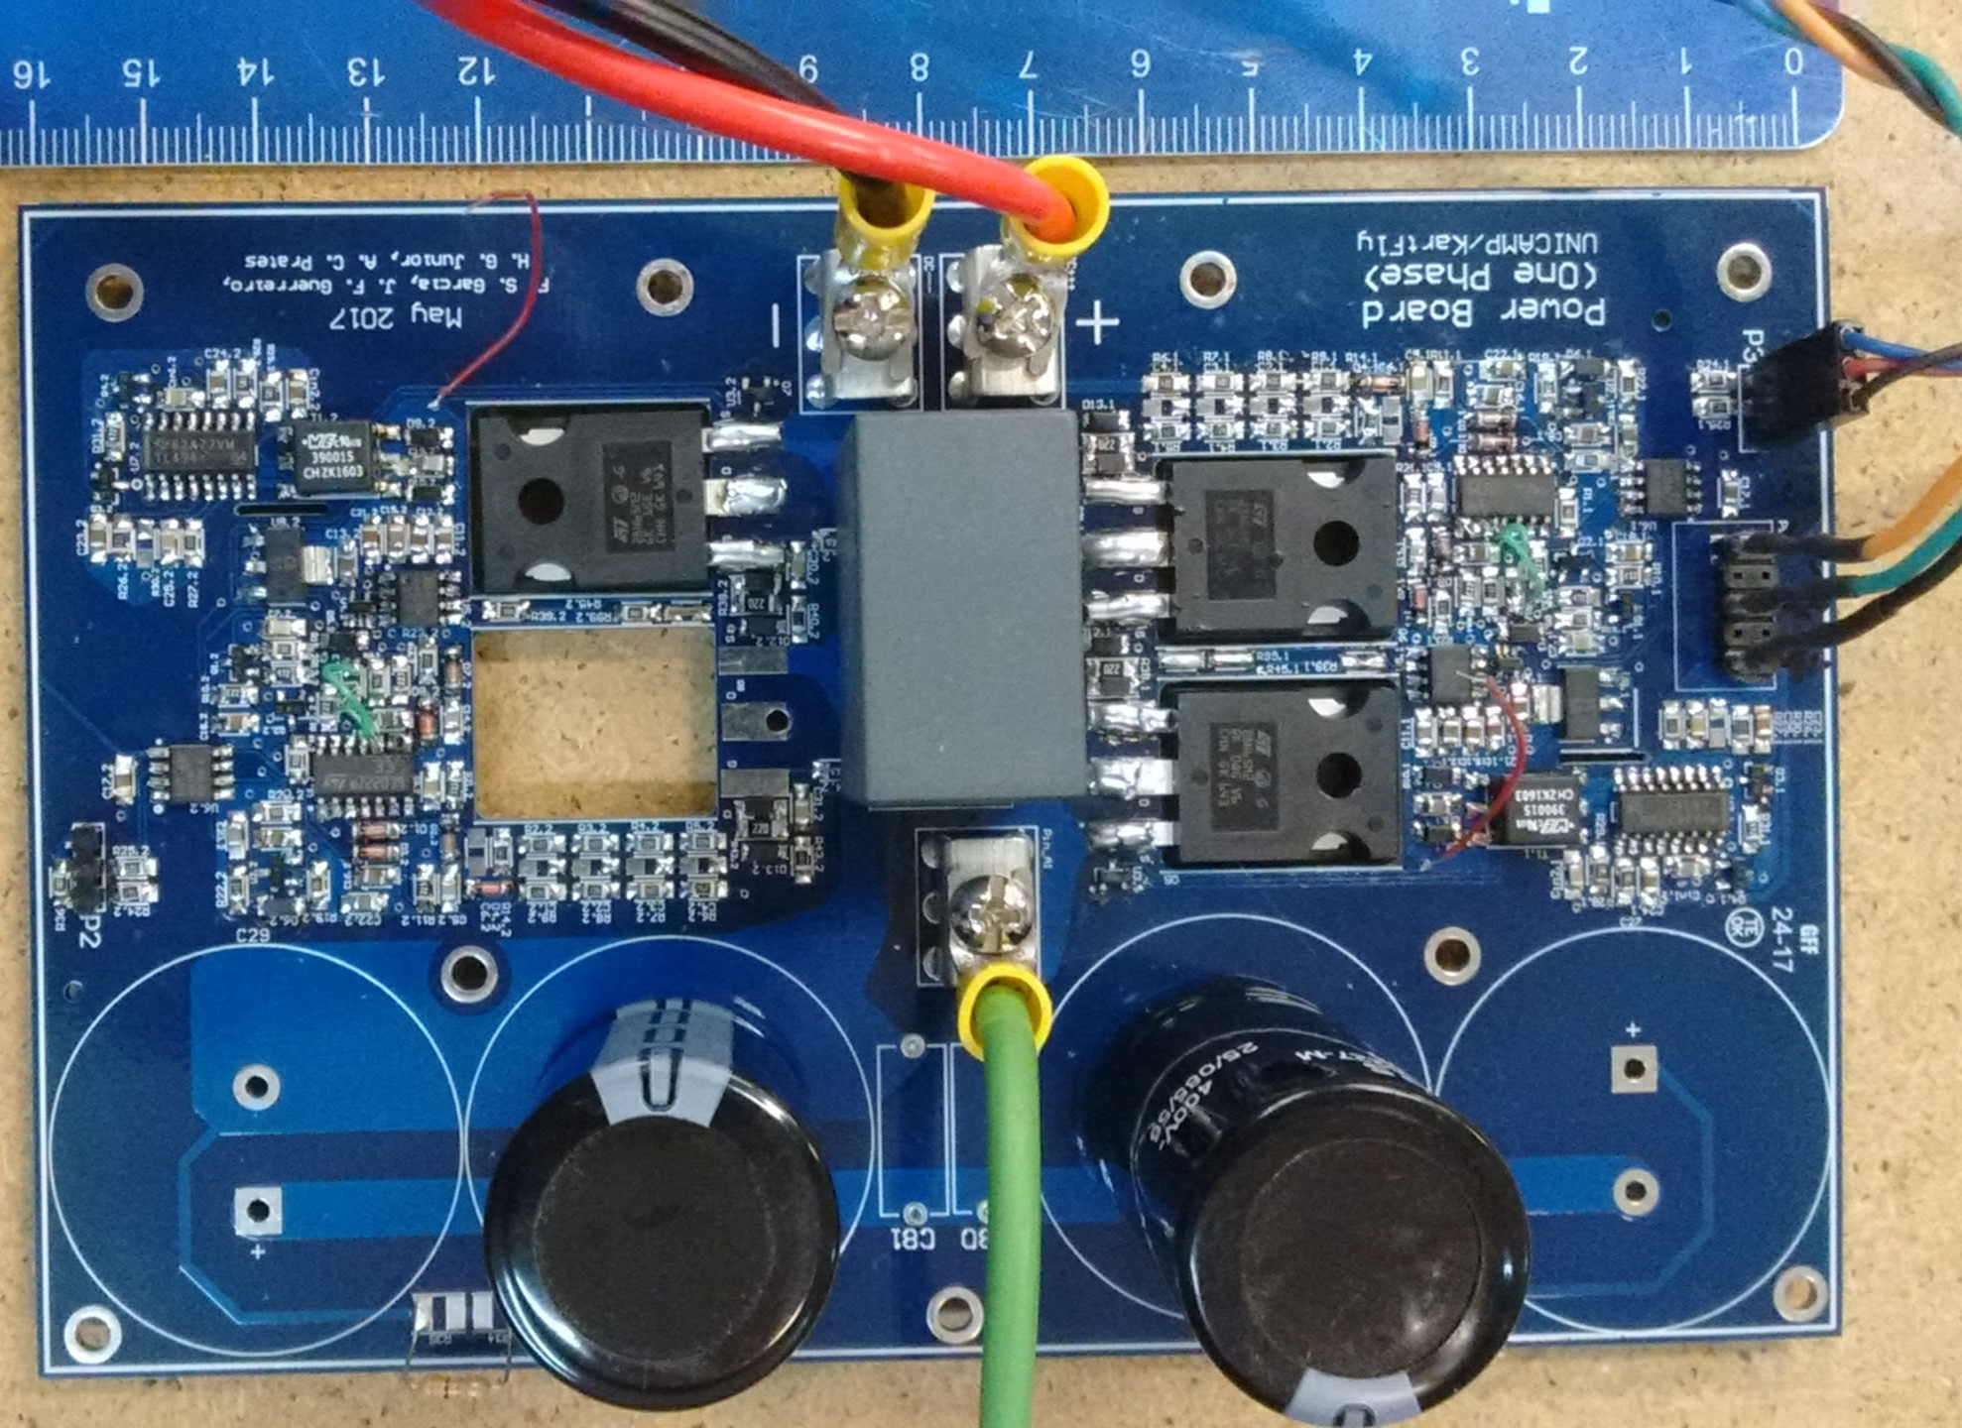
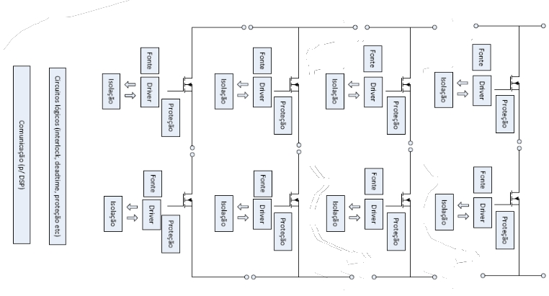
UNICAMP – Universidade Estadual de Campinas
FEEC – Faculdade de Engenharia Elétrica e Computação
Three-phase Inverter Development
for Distributed Generations Purpose
Arthur C. Prates, José A. Pomílio, Hildo Guillardi Jr., Joel F. Guerreiro, Fellipe S. Garcia
arthurcprates@gmail.com, antenor@fee.unicamp.br, hildogjr@dsce.fee.unicamp.br,joel.engeletrica@gmail.com,fsgarcia@gmail.com
Key words
Power electronics, CC-CA Converter, PCB Layout, MOSFET driver
Introduction
Systems of distributed energy, based in solar panels or battery banks, need a CC-CA converter for it’s connection to the grid. The current energy regulation in Brazil aims mainly the power injection in the grid, but none is said about a better voltage profile or harmonics compensation, especially using inverters. Multi-level inverters are capable to perform these tasks due its arrangement and logic system.
As the legislation is changing is urgent the need of a open source device capable to provide the base for research in this field and prepare the new engineers.
Figure 2. Chronology of the project
Results and Discussion
During the validation many changes and arrangements were made in order to satisfy volume, time of response and transients necessities. Also, we kept the ideia of a low cost project, designing many circuits that are found integrated in the market, but with a higher price.
The main power supply can be fed by any off the shelf notebook supplier, the protection can be adjusted acording to the choosen switching device and the driver has a snubber in order to mitigate transient ressonances.
The switching process of half bridge is shown in figure 3 by 100VDC and 78kHz. The half bridge is presented in figure 4.
Metodologia
The concept of the project aimed a 4 Leg inverter, capable of 800V and 200kHz switching frequency for academic researchs. The high limits are needed because of the modular concept of the whole, each module can be placed in different positions in order to achieve other topologies.
To design the concept module, the project was split in 5: Main power supply, isolated power supply, protection/gate driver and logic circuits. As a group procedure, each part was made, tested and validated separately. More informations can be get at <https://github.com/hildogjr/easyInverter> under GNU-GPL3 license.
Figure 3. Half bridge switching at 100VDC 78kHz
Figure 4. Complete half bridge module
Conclusion
The project presented itself as a challenge in many parts. Some effort still need to be done towards the ease of the noise presented in the switching phase in higher frequencies in order to allow the focus on the fine tuning of the protection and further built of the whole system.
We believe that soon we will have a functioning Inverter ready to be used and understand that some barriers take a longer time to be pushed in a state of the art project.
Figure 1. Inverter’s block diagram

